Slide 1
Bootstrap Button
Presented by – Srushti Margale

Slide 2
Button Style
There are many types of button styles. As listed below.
Basic
Default
Primary
Success
Info
Warning
Danger
Link

Slide 3
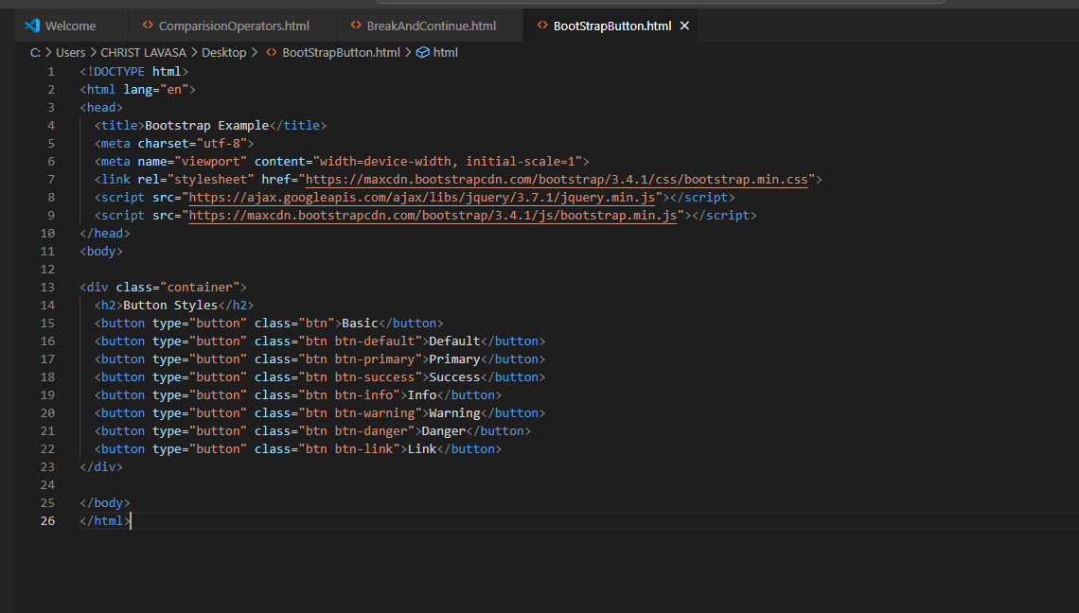
Example of button style

Slide 4
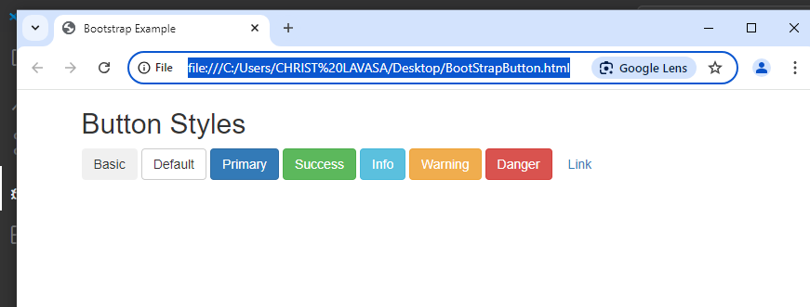
Output

Slide 5
Button Sizes
Bootstrap provides four button sizes.
Large
Normal
Small
XSmall
There are some classes than can be we used to display button sizes.
.btn-lg
.btn-sm
.btn-xs

Slide 6
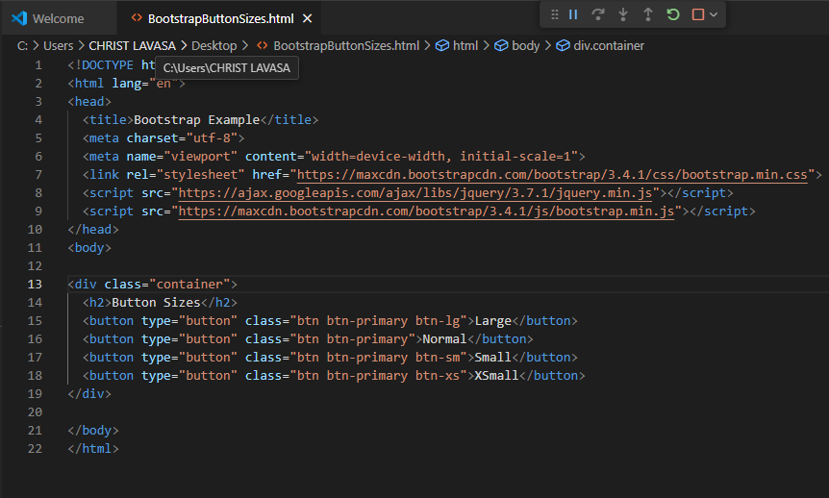
Example of Button Sizes

Slide 7
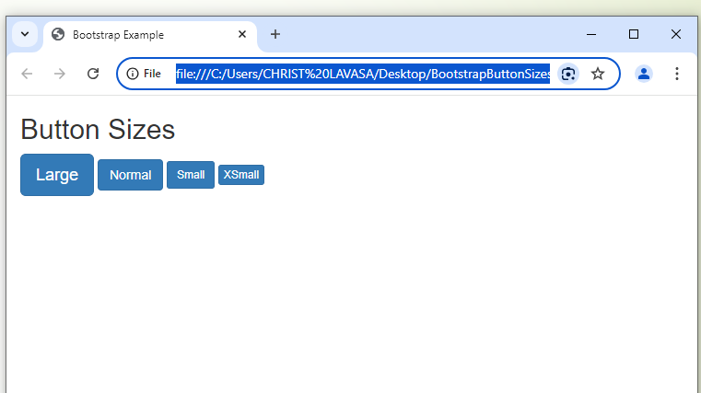
Output

Slide 8
Block Level Button
A block level button spans the entire width of the parent element.
Example:
Types of Block Level Buttons:
Block Level Button
Large Block Level Button
Small Block Level Button
Page
Button 1
Button2

Slide 9
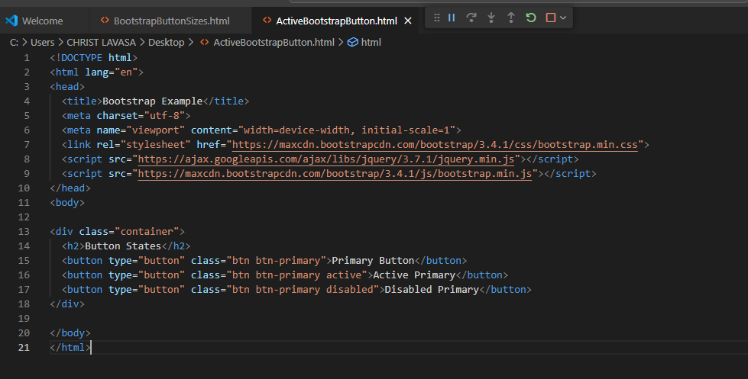
Active/Disabled Buttons
A button can be set to an active (appear pressed) or a disabled (unclickable) state:
Active Primary
Disabled Primary
The class .active makes a button appear pressed, and the class .disabled makes a button unclickable:

Slide 10
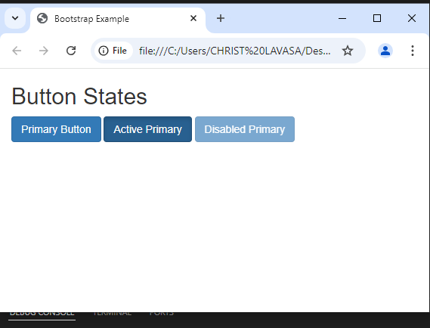
Output:

Slide 11
THANK YOU!!!

